Slide 1
Election Day Clips

Slide 2
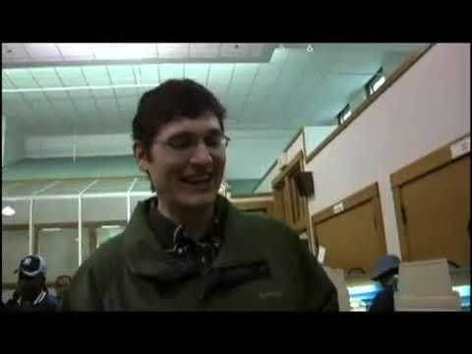
Notes:
Ohio - 2:40
What was the polling place like? (Was it empty, crowded, busy, calm?) Why couldn’t the man with the dark hair and glasses vote? (He thought he had registered at the DMV, but his name wasn’t on the list of registered voters.) Why do you think the woman with the baby was so motivated to vote? (Answers will vary)

Slide 3
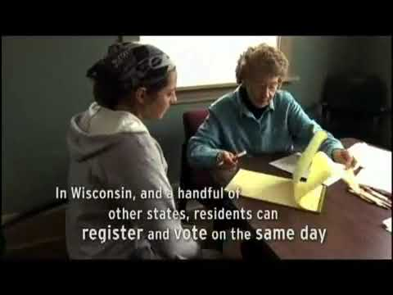
Notes:
Wisconsin - 1:36
Ask students how this polling environment compared with the one shown from Ohio. What Wisconsin law made it possible for the 18-year-old girl to just show up and vote in her first election? (Wisconsin law allows same-day voter registration.) What was her ballot like? (It was a paper and pencil ballot.) How did her voting experience compare with the woman with the baby in the first video clip? Based on what the students have seen, how did voter registration procedures affect participation?

Slide 4
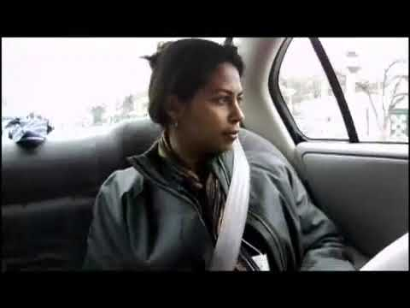
Notes:
Missouri Part 1 - 2:45
Explain that the woman shown traveling from one polling place to another is a poll watcher from Fair Election International. She observes the voting process on election day and writes a report about what happened. Ask students to note what differences she observed at the polling places in the poor area versus the affluent area. Explain that the long lines in the poor area continued throughout the day.

Slide 5
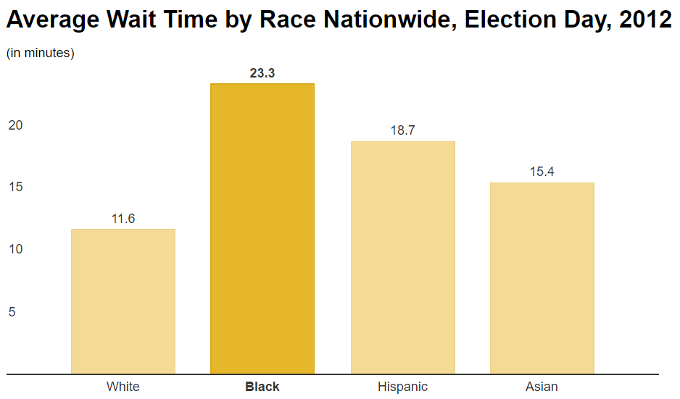
Notes:
http://www.motherjones.com/politics/2014/10/minority-voters-election-long-lines-id

Slide 6
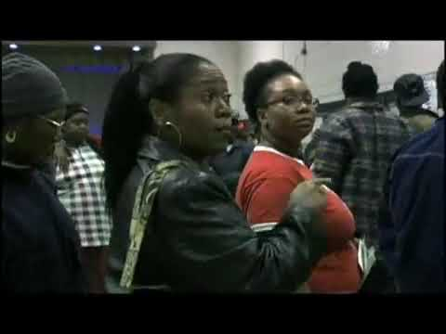
Notes:
Missouri Part 2 - 1:58
Tell students that Fair Election International’s report pointed out that low-income areas of St. Louis had fewer machines and poll workers than wealthier areas. Ask students to discuss the implications of Fair Election International’s findings.

Slide 7
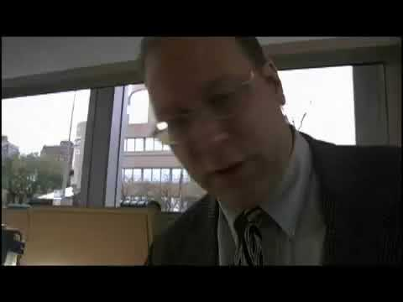
Notes:
Illinois - 2:09
Remind students about the paper and pencil ballot shown in the second clip. Tell students that this clip shows another kind of paper ballot, in which voters use a tool to punch out a hole next to the candidate they choose. Explain that there are many different types of voting systems and machines in place all over the country. Some voters use lever machines, others use touch screen electronic devices. There are even scanner cards in which voters blacken in ovals next to their candidates (similar to how many standardized tests are taken in schools). Ask the class why they think there are so many different types of systems and machines. (Cost usually drives the decision to implement certain voting devices.)

Slide 8
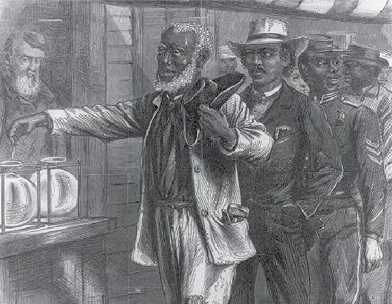
1869: 15th Amendment
The 15th amendment gave African Americans the right to vote
However, states implemented unfair literacy tests and poll taxes to better control who could actually vote
Notes:
Explain how even small poll taxes could be really hard to afford

Slide 9
Questions from a real literacy test
Draw a line around the number or letter of this sentence.
Circle the first, first letter of the alphabet in this line.
In the first circle below write the last letter of the first word beginning with “L”.
Write the word “noise” backwards and place a dot over what would be its second letter should it have been written forward.
Spell backwards, forwards.
Notes:
http://www.slate.com/blogs/the_vault/2013/06/28/voting_rights_and_the_supreme_court_the_impossible_literacy_test_louisiana.html
The “1” at the start of the question should be circled
The “a” in alphabet should be circled
The left-most circle should have a “t” in it
“esiȯn” (note the dot over the o)
“backwards”

Slide 10
Questions from a real literacy test
Print the word vote upside down, but in the correct order.
What do you read in the triangle below?
Write right from the left to the right as you see it spelled here.
Divide a vertical line in two equal parts by bisecting it with a curved horizontal line that is only straight at its spot bisection of the vertical.
Paris in the the spring
Notes:
http://www.slate.com/blogs/the_vault/2013/06/28/voting_rights_and_the_supreme_court_the_impossible_literacy_test_louisiana.html
6. ʌoʇǝ
7. Paris in the the spring
8. right
9. A vertical line with a shallow curve going from left to right, and the bottom (horizontal part) of the curve is where it meets the vertical line (shape is hidden to the left of the slide)

Slide 11
Questions from a real literacy test
Will you bear arms for your country when called upon to do so?
Name some of the duties and obligations of citizenship.
In what State Senatorial District do you live, and what are the names of the counties in such district?
How does the Constitution of the United States provide that it may be amended?
Name the attorney general of the United States.
What does the Constitution of the United States provide regarding the suspension of the privilege of the Writ of Habeas Corpus?
Notes:
http://www.crmvet.org/info/gavr_training.pdf
http://www.americanbar.org/content/dam/aba/administrative/public_education/resources/BarrierstoVoting.authcheckdam.pdf
10. Yes
11. (subjective)
12. For example, Kent WA is in District 11, King County
13. Article V. states the congress, whenever 2/3 of both houses shall deem it necessary, shall propose amendments to this constitution or on the application of the legislature of 2/3 of the several states shall call a convention for proposing amendments, which either case shall be valid to all intents and purposes, as part of this constitution, when ratified by the legislature of ¾ of the several states or by conventions in ¾ thereof as the one or the other mode of ratification may be proposed by the congress
14. Loretta Lynch
15. Under the US Constitution it cannot be done unless when in case of rebellion or invasion the public safety may require it

Slide 12
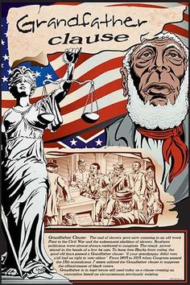
1898: Grandfather clauses
Louisiana, Mississippi, South Carolina, Alabama and Virginia pass laws saying anyone whose father or grandfather could vote before the Civil War could skip poll taxes and literacy tests
In Louisiana, the percentage of African Americans registered to vote drops from 45% to 4%

Slide 13
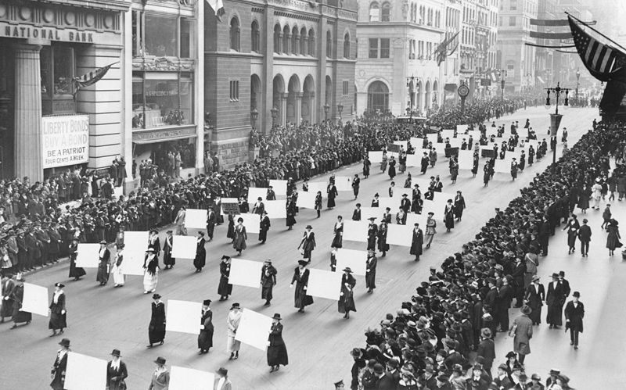
1920: 19th Amendment
The 19th Amendment gave women the right to vote for the first time

Slide 14
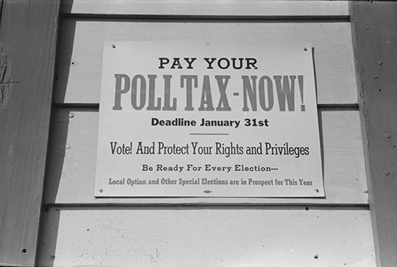
1964: 24th Amendment
The 24th Amendment outlawed poll taxes

Slide 15
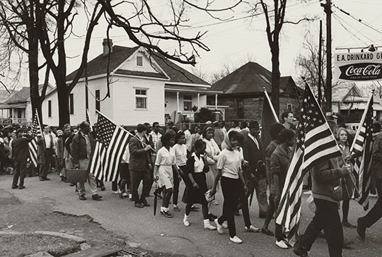
1965: Selma to Montgomery
500 civil rights supporters, marching from Selma to Montgomery to demand voting rights for African Americans, are attacked by police

Slide 16
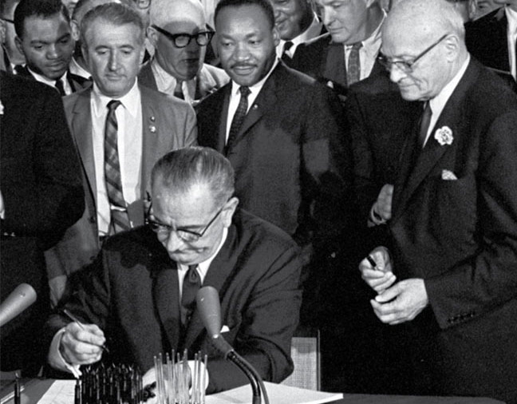
1965: Voting Rights Act
The Voting Right Act outlaws any barriers to voting based on race
It also requires many states with a history of discrimination to get federal approval for any changes to their election laws

Slide 17
2013: Supreme Court rules against section of the VRA
The US Supreme Court determines (in a 5-4 vote) that the way the Voting Rights Act determines which states must get approval on law changes is unconstitutional
Suddenly, those states with a history of voter discrimination can pass just about any law they want

Slide 18
Voter fraud
Notes:
http://www.motherjones.com/politics/2012/07/voter-id-laws-charts-maps
http://www.pbs.org/wgbh/frontline/article/why-doesnt-everybody-have-a-voter-id/
http://www.motherjones.com/politics/2014/10/minority-voters-election-long-lines-id
http://www.motherjones.com/politics/2012/07/voter-suppression-kevin-drum

Slide 19
Voting fraud
There are many types of voting fraud, including:
Impersonation
Double voting
Vote buying
Absentee vote fraud
Voting while ineligible
A conviction results in up to five years in prison and a $10,000 fine

Slide 20
Voting fraud – how often does it happen?
Most “voter fraud” is due to typos and other innocent errors in data
In cases where voter fraud has been reported “widespread”, sending the media into a frenzy, the rate of fraud consistently lands around .0003% - a handful of votes out of millions.
These are most commonly double voters (voters registered to vote in multiple counties or states) and ineligible voters who are still listed as eligible to vote.
Notes:
http://www.brennancenter.org/sites/default/files/legacy/The%20Truth%20About%20Voter%20Fraud.pdf

Slide 21
Voter ID Laws
Voter ID laws were passed in ~30 states to prevent impersonation.
Types of ID:
Social security card
Passport
Driver’s license
Citizenship card
Military ID
Non-driver’s ID
- no photo, so it’s not eligible
- expensive, less than 50% of Americans have one
- only if you have a car
- only if you’re born in another country
- only if you’re in the military
- need birth certificate, which can be challenging if you’ve lost it, and usually costs money

Slide 22
Impersonation – how often does it happen?
Between 2000 and 2014, there were:
834,000,000 votes cast in general elections
76,000 reported UFO sightings
465 Americans killed by lightning
31 cases of impersonation

Slide 23
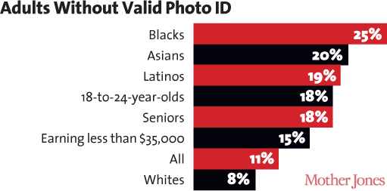
Voter ID is discriminatory
In North Carolina in 2013:
Percentage of registered Democratic voters lacking ID: 8.9%
Percentage of registered Republican voters lacking ID: 3.4%
Notes:
http://www.motherjones.com/politics/2012/07/voter-id-laws-charts-maps
http://nc-democracy.org/downloads/SBOEDataNoIDApril2013PR.pdf

Slide 24
Is it intentional?
From a Houston Chronicle interview with Royal Masset, the former political director for Texas’ Republican Party:
Among Republicans it is an “article of religious faith that voter fraud is causing us to lose elections,” Masset said. He doesn’t agree with that, but does believe that requiring photo IDs could cause enough of a dropoff in legitimate Democratic voting to add 3 percent to the Republican vote.
Notes:
Royal Masset, the former political director for the Republican Party of Texas, concisely tied all of these strands together in a 2007 Houston Chronicle article concerning a highly controversial battle over photo identification legislation in Texas. Masset connected the inflated furor over voter fraud to photo identification laws and their expected impact on legitimate voters:
http://www.brennancenter.org/sites/default/files/legacy/The%20Truth%20About%20Voter%20Fraud.pdf

Slide 25
Let’s compare those numbers
Based on statistics from past elections, the likely number of cases of impersonation
Fewer than 10
Americans for whom it is now significantly harder to vote because of voter ID laws
More than 5,000,000

Slide 26
What other state laws affect voters?
Shorter voting hours
Earlier voter registration deadlines
Removal of same-day voter registration
Removal or reduction of early voting
Restrictions on voter registration drives
Restrictions on whether ex-felons can vote
Notes:
http://www.motherjones.com/mojo/2013/07/north-carolina-voter-id-bill-section-5-voting-rights-act
http://www.motherjones.com/politics/2014/10/voting-rights-november-voter-suppression-states

Slide 27
How much does this matter?
Let’s talk about the 2000 Presidential election in Florida
A private organization created a list of 58,000 names that should be purged from the list of eligible voters, because they were ex-felons
This list had a lot of mistakes
Notes:
http://www.motherjones.com/politics/2015/10/jeb-bush-florida-felon-voting-rights-clemency

Slide 28
How much does this matter?
After the election, the company was ordered to double-check the list
There were 12,000 eligible voters mistakenly on the list
President George W. Bush won Florida (and, thus, the election) by 537 votes
Notes:
http://www.motherjones.com/politics/2015/10/jeb-bush-florida-felon-voting-rights-clemency
https://www.thenation.com/article/how-the-2000-election-in-florida-led-to-a-new-wave-of-voter-disenfranchisement/

Slide 29
Voting Modernization
It’s not all bad!
Notes:
http://www.brennancenter.org/analysis/voter-registration-modernization-states
http://www.motherjones.com/politics/2012/07/digital-voting-machines-fail-hacked
https://people.csail.mit.edu/rivest/pubs/AKSRx12.pdf
https://en.wikipedia.org/wiki/Electronic_voting
http://www.commoncause.org/research-reports/OR_080409_Report_Improving_Voter_Participation_2.pdf
http://www.theatlantic.com/politics/archive/2013/04/a-simple-plan-to-drastically-improve-voting-stop-fraud-and-save-money/275074/
http://news.blogs.cnn.com/2012/01/03/overheard-on-cnn-com-10-ideas-to-improve-voting-elections/
https://www.brennancenter.org/analysis/4-simple-ways-improve-voting

Slide 30
Improvements over the last 20 years
Automatic voter registration at the DMV (five states)
Same-day registration (fifteen states)
Online registration (thirty-nine states, including WA)
Early voting and absentee voting
Electronic voting machines that aren’t terrible
Provisional ballots (2,100,000 in 2008, 62% of which were accepted)
Notes:
http://people.csail.mit.edu/rivest/pubs/AKSRx12.pdf
http://www.brennancenter.org/analysis/voter-registration-modernization-states

Slide 31
Online voting – the future?
Security – hacks, viruses, phishing
Access – 12% of Americans do not use the internet, many more don’t have access at home
Today, Americans overseas (in the military, living abroad and in space) can submit absentee ballots by email
Countries like France, Canada and Australia have experimented with online voting, but have faced serious issues and security concerns
Notes:
http://www.commoncause.org/research-reports/OR_080409_Report_Improving_Voter_Participation_2.pdf
http://www.internetlivestats.com/internet-users/
http://www.livescience.com/24521-online-voting-risks.html
http://www.futurity.org/internet-online-voting-1176522-2/

Slide 32
So how do we fix this?
51 million eligible Americans are not registered to vote
3 million Americans showed up to vote in the 2008 election only to be turned away for being ineligible
Different types of ballots and electronic voting options have different issues – which is best?
Notes:
http://www.theatlantic.com/politics/archive/2013/04/a-simple-plan-to-drastically-improve-voting-stop-fraud-and-save-money/275074/

